Slide 1
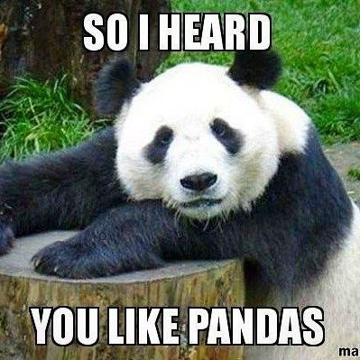
EDA & Wrangling Using Pandas
LECTURE 3
Using Pandas for Exploratory Data Analysis
CSCI 3022 @ CU Boulder
Dr. Osita Onyejekwe
Content credit: Acknowledgments

Slide 2


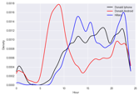
Plan for first 2 weeks
?
Question & Problem
Formulation
Data
Acquisition
Prediction and
Inference
Exploratory Data Analysis
Reports, Decisions, and Solutions
(Weeks 1)
EDA, Wrangling, and Data Visualization

Slide 3
EDA & Wrangling
Lesson 3:
EDA - 5 key properties to consider
EDA Jupyter Demo
Lesson 3 Learning Objectives:
Identify 5 key data properties to consider when doing Exploratory Data Analysis
Define what is meant by structure and granularity in terms of a set of data, and identify the structure and granularity of sample datasets
Practice EDA with sample data

Slide 4
File Format
Variable Type
Multiple files (Primary and Foreign Keys)
Structure -- the “shape” of a data file
Granularity -- how fine/coarse is each datum
Scope -- how (in)complete is the data
Temporality -- how is the data situated in time
Faithfulness -- how well does the data capture “reality”
Key Data Properties to Consider in EDA

Slide 5
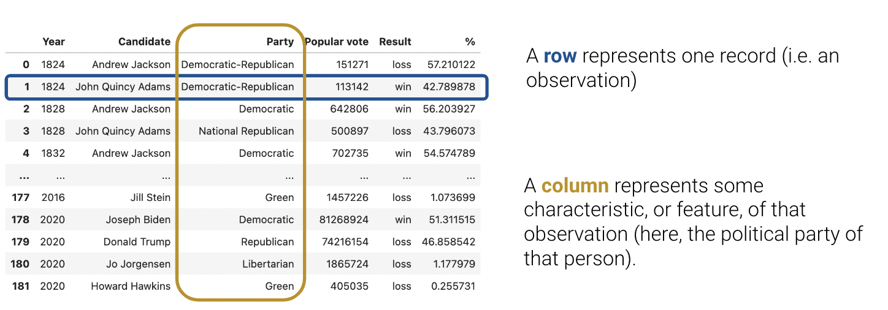
Variables Are Columns
What does each column represent?
A variable is a measurement of a particular concept.
It has two common properties:
Datatype/Storage type: How each variable value is stored in memory. df[colname].dtype
integer, floating point, boolean, object (string-like), etc.
Affects which pandas functions you use.
Variable type/Feature type: Conceptualized measurement of information (and therefore what values it can take on).
Use expert knowledge
Explore data itself
Consult data codebook (if it exists).
Affects how you visualize and interpret the data.
Storage types say what operations we can write code to compute, while feature types say what operations make sense for the data.
⚠️In this class, “variable types” are conceptual!!
Notes:
Or df.info() to get a more comprehensive output
business_id business_name business_address business_city business_state business_postal_code business_latitude business_longitude business_location business_phone_number ... inspection_score inspection_type violation_id violation_description risk_category Neighborhoods SF Find Neighborhoods Current Police Districts Current Supervisor Districts Analysis Neighborhoods
0 835 Kam Po Kitchen 801 Broadway St San Francisco CA 94133 37.797223 -122.410513 POINT (-122.410513 37.797223) NaN ... 88.0 Routine - Unscheduled 835_20180917_103139 Improper food storage Low Risk 107.0 107.0 6.0 3.0 6.0
1 905 Working Girls'

Slide 6
Variable Feature Types
Variable
Many variables do not sit neatly in one of these categories!!
Ratios and intervals have consistent meaning.
Quantitative
Qualitative (categorical)
Continuous
Discrete
Ordinal
Nominal
Could be measured to arbitrary precision.
Stored as integers where intervals have consistent meaning
Categories w/ordered levels; no consistent meaning to difference
Categories w/ no
specific ordering.
Examples:
Price
Temperature
Examples:
Number of siblings
Yrs of education
Examples:
Preferences
Level of education
Examples:
Political Affiliation
CU lD number
Note that qualitative variables could have numeric levels; conversely, quantitative variables could be stored as strings!

Slide 7
Class Exercise
🤔
What is the feature type of each variable?
Variable
Quantitative
Qualitative
Q | Variable | Feature Type
1 | CO₂ level (PPM)
2 | Number of siblings
3 | GPA
4 | Income bracket (low, med, high)
5 | Race
6 | Number of years of education
7 | Yelp Rating
Cont- inuous
Dis- crete
Ord- inal
Nom- inal
A
B
C
D
Notes:
ppm: parts per million

Slide 8
Class Exercise: Solutions
🤔
What is the feature type of each variable?
Variable
Quantitative
Qualitative
Q | Variable | Feature Type
1 | CO₂ level (PPM)
2 | Number of siblings
3 | GPA
4 | Income bracket (low, med, high)
5 | Race
6 | Number of years of education
7 | Yelp Rating
A. Quantitative Cont.
B. Quantitative Discrete
A. Quantitative Cont.
C. Qualitative Ordinal
D. Qualitative Nominal
B. Quantitative Discrete
C. Qualitative Ordinal
Cont- inuous
Dis- crete
Ord- inal
Nom- inal
A
B
C
D
*see speaker notes
*
Meta: For this exercise, The Feature Type variable is Qualitative Nominal.
*
Notes:
There are several common questions that come in lecture about this:
Couldn’t GPA be quantitative discrete, since technically there are a finite number of possible GPAs?
Couldn’t Number of years of education be Qualitative Ordinal, since a gap of a “year” is dependent on when that year of education occurred?
Couldn’t Yelp Rating be quantitative discrete for the same reasons as GPA?
The answer to all these questions (except education, see below) is: “Yes, it could! But it depends on what question you are trying to answer with data.” We’ll see next week that many of these feature types are tied to how you’d want to visualize data. Would you want to scatterplot GPA, or do you want to lineplot GPA? How do you want to present Yelp Ratings—categorically (e.g. bar plot), or quantitatively (e.g., scatter plot)? What story are you asking from the data?
Side note on education: I usually prefer asking education level as a Qualitative Nominal variable— high school, Undergrad, Master’s, PhD, etc.—precisely because of the above points. As data scientists working with educational data it’s highly likely that you won’t care about quantitatively comparing number of years; you probably care more about type (i.e., category) of education.

Slide 9
Structure -- the “shape” of a data file
Granularity -- how fine/coarse is each datum
Scope -- how (in)complete is the data
Temporality -- how is the data situated in time
Faithfulness -- how well does the data capture “reality”
Key Data Properties to Consider in EDA

Slide 10
Primary Keys
Primary Key
Customers.csv
Primary key: the column or set of columns in a table that uniquely determine the values in the remaining columns
Primary keys are unique, but could be tuples.
Examples: SSN, ProductIDs, …
CustID | Addr
171345 | Harmon..
281139 | Main ..
Primary Key
Orders.csv
OrderNum | CustID | Date
1 | 171345 | 8/21/2017
2 | 281139 | 8/30/2017
Products.csv
ProdID | Cost
42 | 3.14
999 | 2.72
Primary Key
Purchases.csv
OrderNum | ProdID | Quantity
1 | 42 | 3
1 | 999 | 2
2 | 42 | 1

Slide 11
Primary Keys & Granularity
Primary Key
Customers.csv
Primary key: the column or set of columns in a table that uniquely determine the values in the remaining columns
Primary keys are unique, but could be tuples.
Examples: SSN, ProductIDs, …
Granularity is the concept the primary key represents.
Example:
Granularity of Customer’s table: Each row represents data for one unique customer.
CustID | Addr
171345 | Harmon..
281139 | Main ..
Primary Key
Orders.csv
OrderNum | CustID | Date
1 | 171345 | 8/21/2017
2 | 281139 | 8/30/2017
Products.csv
ProdID | Cost
42 | 3.14
999 | 2.72
Primary Key
Purchases.csv
OrderNum | ProdID | Quantity
1 | 42 | 3
1 | 999 | 2
2 | 42 | 1

Slide 12
Granularity
What does each record (row) represent?
Examples: a purchase, a person, a group of users, a house, a team
Do all records capture granularity at the same level?
Some data will include summaries (aka rollups) as records
How were the records aggregated?
Sampling, averaging, …
Rec. 1
Rec. 1
Rec. 2
Rec. 3
Rec. 1
Rec. 2
Rec. 3

Slide 13
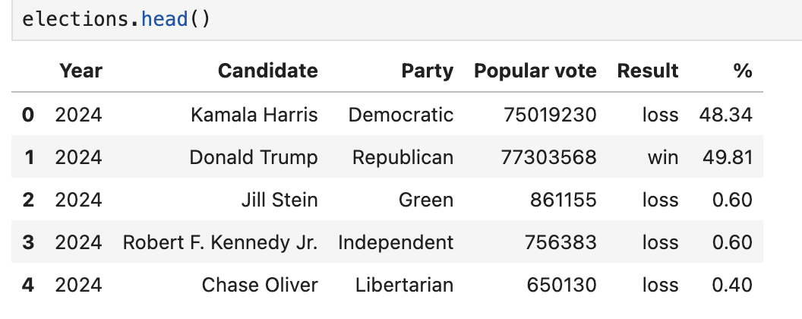
iClicker Poll:
Based on the first 5 rows of the DataFrame, what appears to be the granularity of the election dataset?
(i.e. each record represents data about a ….)
A). Presidential Candidate
B). Political Party
C). Political Party in a Specific Year
D). Presidential Candidate in a Specific Year
E). Candidate in a Political Party
How could we determine the granularity of the whole dataset?

Slide 14
iClicker Poll:
Based on the first 5 rows of the DataFrame, what appears to be the granularity of the election dataset?
(i.e. each record represents data about a ….)
A). Presidential Candidate
B). Political Party
C). Political Party in a Specific Year
D). Presidential Candidate in a specific year
E). Candidate in a Political Party
What Pandas functions do we need to use to determine the granularity of the whole dataset?
Need to select a subset of column(s) that we think represent granularity
Need to a way to determine uniqueness of entries in multiple columns

Slide 15
Structure -- the “shape” of a data file
Granularity -- how fine/coarse is each datum
Scope -- how (in)complete is the data
Temporality -- how is the data situated in time
Faithfulness -- how well does the data capture “reality”
Key Data Properties to Consider in EDA

Slide 16
Scope
Will my data be enough to answer my question?
Example: I am interested in studying crime in California but I only have Berkeley crime data.
Solution: collect more data/change research question
Is my data too expansive?
Example: I am interested in student grades for Data100 but have student grades for all Data Science classes.
Solution: Filtering ⇒ Implications on sample?
If the data is a sample I may have poor coverage after filtering (More on this next week)
Does my data cover the right time frame?
Which brings us to Temporality
“Scope” questions are defined by your question/problem and inform if you need better-scoped data.

Slide 17
Temporality
Data changes – when was the data collected/last updated?
Periodicity — Is there periodicity? Diurnal (24-hr) patterns?
What is the meaning of the time and date fields? A few options:
When the “event” happened?
When the data was collected or was entered into the system?
Date the data was copied into a database? (look for many matching timestamps)
Time depends on where! (time zones & daylight savings)
Learn to use datetime Python library and Pandas dt accessors
Regions have different datestring representations: 07/08/09?
Are there strange null values?
E.g., January 1st 1970, January 1st 1900…?
Notes:
July 8th 2009?
8th of July 2009?
2007 July 8th?

Slide 18
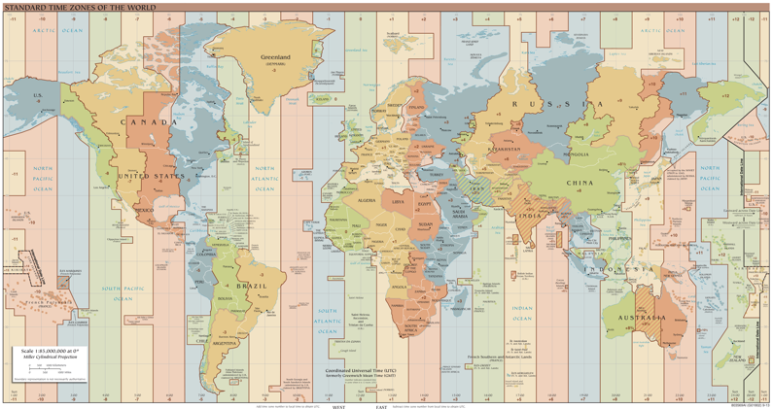
Temporality: Unix / POSIX Time
Time measured in seconds since January 1st 1970 UTC
Minus leap seconds …
UTC is Coordinated Universal Time
International time standard
Measured at 0 degrees latitude
Similar to Greenwich Mean Time (GMT)
No daylight savings
Time Zones:
San Francisco (UTC-7) with daylight savings
Jun 27, 2023 5:00pm PDT
1687910400
https://en.wikipedia.org/wiki/Coordinated_Universal_Time
Notes:
https://en.wikipedia.org/wiki/Coordinated_Universal_Time
The official abbreviation for Coordinated Universal Time is UTC. This abbreviation comes as a result of the International Telecommunication Union and the International Astronomical Union wanting to use the same abbreviation in all languages. English speakers originally proposed CUT (for "coordinated universal time"), while French speakers proposed TUC (for "temps universel coordonné"). The compromise that emerged was UTC,
Coordinated Universal Time (UTC) is the primary time standard globally used to regulate clocks and time. It establishes a reference for the current time, forming the basis for civil time and time zones. UTC facilitates international communication, navigation, scientific research, and commerce.

Slide 19
Structure -- the “shape” of a data file
Granularity -- how fine/coarse is each datum
Scope -- how (in)complete is the data
Temporality -- how is the data situated in time
Faithfulness -- how well does the data capture “reality”
What else?

Slide 20
Faithfulness: Do I trust this data?
Does my data contain unrealistic or “incorrect” values?
Dates in the future for events in the past
Locations that don’t exist
Negative counts
Misspellings of names
Large outliers
Does my data violate obvious dependencies?
E.g., age and birthday don’t match
Was the data entered by hand?
Spelling errors, fields shifted …
Did the form require all fields or provide default values?
Are there obvious signs of data falsification?
Repeated names, fake looking email addresses, repeated use of uncommon names or fields.

Slide 21
Signs that your data may not be faithful (and proposed solutions)
Truncated data Early Microsoft Excel limits: 65536 Rows, 255 Columns
Duplicated Records or Fields
Identify and eliminate (use primary key).
Be aware of consequences in analysis when using data with inconsistencies.
Understand the potential implications for how data were collected.
Spelling Errors
Apply corrections or drop records not in a dictionary
Units not specified or consistent
Infer units, check values are in reasonable ranges for data
Missing Data???
Examples
" “
0, -1 999, 12345
1970, 1900
NaN
Null
Time Zone Inconsistencies
Convert to a common timezone (e.g., UTC)
NaN: “Not a Number”

Slide 22
Missing Data/Default Values: Solutions
A. Drop records with missing values
Caution: check for biases induced by dropped values
When modeling data you can’t drop missing values in your test/validation sets
Missing or corrupt records might be related to something of interest
Choice affects bias and uncertainty quantification (large statistics literature)
Essential question: why are the records missing?
B. Keep as NaN
C. Imputation/Interpolation: Inferring missing values
Average Imputation: replace with the mean
When the variable’s distribution is roughly bell shaped, or mostly crowded at the mean
Median Imputation: replace with the median
When the variable’s distribution is skewed (not crowded at the mean, rather at the left or right of it)
Mode Imputation: replace with the mode
When the variable is frequently going to be a specific value, there is a high chance that the mode is the right inherent value for such data
Zero: Replace with zero if it makes sense in the context of the data
Other Imputation Strategies (out of scope for this class)
Hot deck imputation: replace with a random value
Regression imputation: replace with a predicted value, using some model

